Slide 1
Unit Tests & TDD
Test Driven Development

Slide 2
Tests flavors
User acceptance
Performance
Function / Integration
Unit Test
Manual Testing

Slide 3
Example: PS4 Blog
We are a team that works for Sony, they want a blog to present the official news of the PlayStation 4.
User Stories
As a user I want to comment on the news so that I interact with other people in the blog.
As a user I want to share the news on any social network so that I can share the articles with my friends
As a Blog Administrator I want to create an article so that I can publish it to the site.

Slide 4
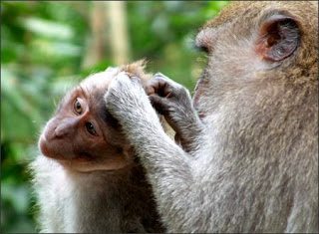
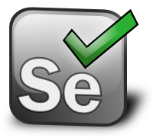
Manual Testing
One guy from our team test the main flow.
Login as an Admin
Create an article
Publish
Login as a user
Comment on the article
Share the article on Facebook
This can be automated by using Slenium

Slide 5
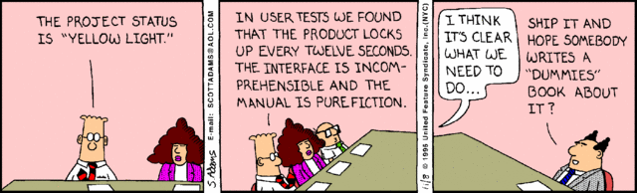
User Acceptance Testing
Responsibility of the End user/ Customer to check functionalities.
No technical knowledge.
Example:
John Doe from Sony, login to the system, add a comment to an article.

Slide 6
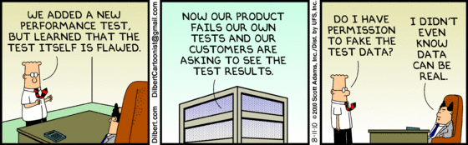
Performance Testing
We have some “Non-Fuctional Requirement”
The system shall be able to support 1 million of users at the same time in peak load.
Save an article shall take less than 3 seconds for the 80% of the cases.
Show a full article shall take at most 2 seconds.
3rd Party Tools for Load Testing.

Slide 7

Functional/Integration Tests
Pick a feature “Add a Comment”
A guy from our team create a test:
Call the method addComment.
addComment calls VerifyFields
addComments calls data access layer to save the comment.
Verify the Comment is in the database.

Slide 8

Unit Test
Pick a method addComment
A guy from our team create a test:
Call the method addComment.
Create a mock of VerifyFields method.
Create a mock of the data access layer.
Verify the method returns true.

Slide 9
A unit test is a piece of code written by a developer that exercises a very small, specific area of functionality of the code being tested.
Unit Test Definition

Slide 10
Unit Test
Smallest Unit of functionality, typically testing a method or a function.
Focusses on one particular feature
Everything it touches should be done in memory
Unit Tests do not:
Access the network
Hit a Database
Use the file system
Any kind of dependency that is Hard to understand, initialize or manipulate should be Stubbed or mocked.

Slide 11
Unit Test - Frameworks
PHP
PHP Unit
SimpleTest
SnapTest
OnionTest
……
Java
Junit
Mockito
HavaRunner
Jukito
PowerMock
http://en.wikipedia.org/wiki/List_of_unit_testing_frameworks

Slide 12
PHP Unit
PHPUnit is a unit testing software framework for software written in the PHP programming language.
Created by Sebastian Bergmann.
PHPUnit is one of the xUnit family of frameworks that originated with Kent Beck's.

Slide 13
Install PHP Unit (PEAR Package)
pear upgrade PEAR
pear config-set auto_discover 1
pear install pear.phpunit.de/PHPUnit

Slide 14
Unit Test – Name Convetion
Test_Method_Parameters_Result
Examples
Test_Add_1and2_3()
Test_Divide_1and0_ExceptionDivideZero()

Slide 15
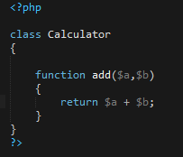

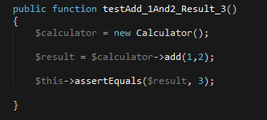
Demo – Unit Test
Source Code
Unit Test

Slide 16
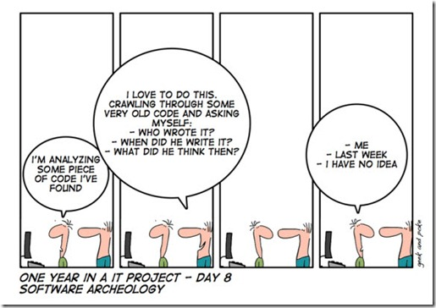
What is TDD?

Slide 17
What is TDD?
It’s a workflow
Push for simplicity
Tests are uses examples
Red, Green, Refactor

Slide 18
TDD Mantra
TDD
Green
Refactor
Red
Write Failing Test
Optimize, clean up without adding new functionality.
Write just enough code to pass test

Slide 19
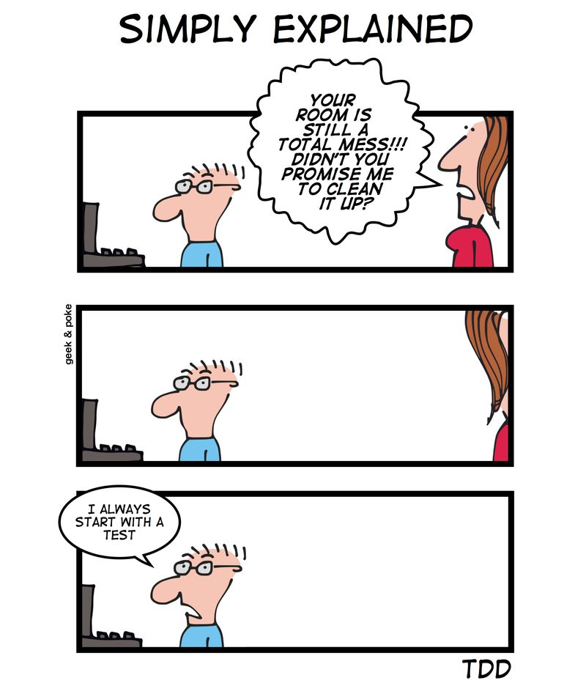
TDD Mantra

Slide 20
TDD Laws
You are not allowed to write any production code unless it is to make a failing unit test pass.
You are not allowed to write any more of a unit test than is sufficient to fail; and compilation failures are failures
You are not allowed to write any more production code than is sufficient to pass the one failing unit test.
http://butunclebob.com/ArticleS.UncleBob.TheThreeRulesOfTdd

Slide 21
Why use TDD?
It makes you think about what you're about to write, before you write it.
Usually the final outcome is better, more expressive and well structured code.
You should test your code for edge cases, invalid inputs and general cases.
It can turn you into a more productive person.

Slide 22
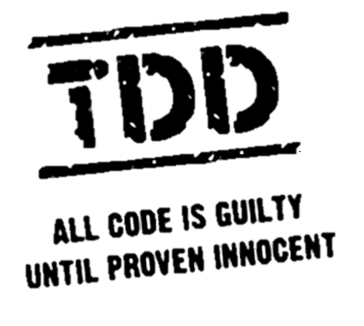
Demo – TDD

Slide 23
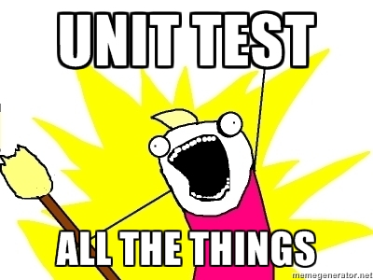
Now you guys!
Rules
Use TDD
Work in pairs
Change the Commander every 20 minutes

Slide 24
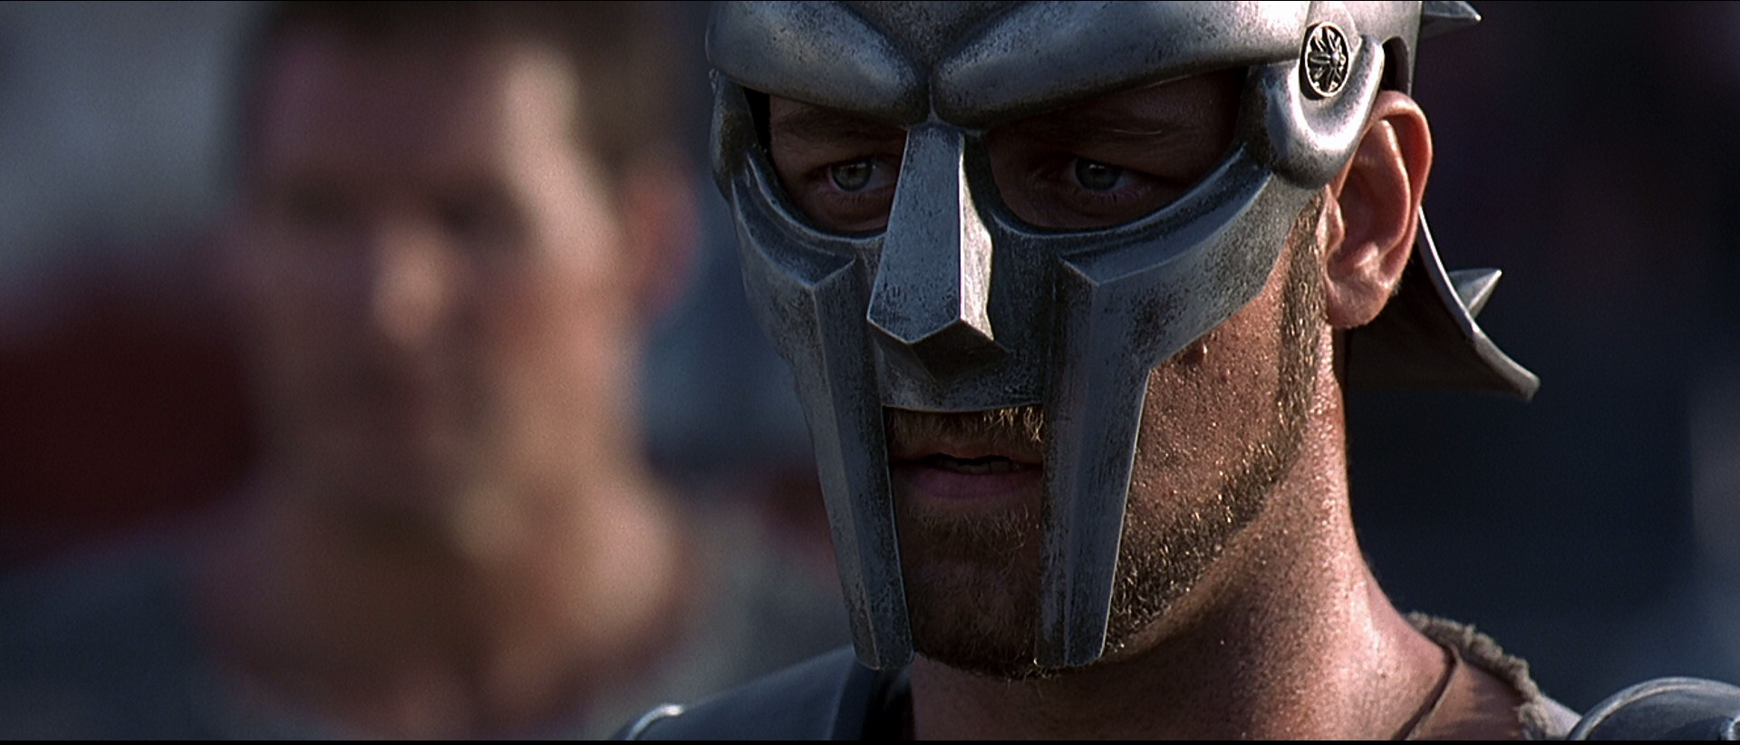
Now you guys!
General Maximus Decimus Meridius leads the Roman army. He is now fighting against the Arabics. In a combat he found some papyrus with the numbers of the Arabic army, but he doesn’t understand the Arabic numbers.
He came to us, asking for help he said
“Marcus Aurelius had a dream that was Rome, guys, we need to convert this numbers to Roman Numbers”
This is the reproduction of the papyrus
Private 895
Sergeant 467
Captain 187
Major 15
Generals 4
Swords 504
Arches 353
Rules
Use TDD
Work in pairs
Change the Commander every 20 minutes

